Slide 1
Secure data hiding in images using steganography
CAPSTONE PROJECT
Presented By: Shrestha Chouksey
Student Name : Shrestha Chouksey
College Name & Department : Gyan Ganga Institute of Technology and Sciences, B.Tech (CSE-AIML)

Slide 2
OUTLINE
Problem Statement
Technology used
Wow factor
End users
Result
Conclusion
Git-hub Link
Future scope

Slide 3
Problem Statement
In today’s digital world, safeguarding sensitive information is essential. Conventional encryption scrambles data, making it unreadable, but it can still raise suspicion. Steganography offers an alternative by concealing messages within common files, such as images, ensuring the hidden content remains unnoticed.
Embed a secret text message inside an image by altering pixel values subtly.
Secure the concealed message using a passcode.
Retrieve and decode the hidden text only with the correct passcode.
Maintain minimal visual distortion so the image appears unchanged.

Slide 4
Technology used
Libraries Used:
cv2 (OpenCV) – Used for image processing (reading, modifying, and saving images).
os – Used to interact with the operating system (opening the encrypted image).
numpy - Used to modify image pixels for hiding and extracting messages.
Platform:
Python : Works with Python 3.x.

Slide 5
Wow factors
Invisible Data Concealment – Unlike traditional encryption, this technique discreetly hides messages within images, making them undetectable to the human eye.
Passcode-Locked Access – Only users with the correct passcode can extract the hidden message, ensuring an extra layer of protection.
Seamless Pixel Modification – Embeds data at the pixel level with minimal alteration, preserving the original image quality.
Lightweight & Fast – Consumes significantly fewer system resources compared to standard cryptographic methods, making it suitable for low-power devices.
Effortless yet Secure – Eliminates the need for complex encryption by leveraging image pixels for safe and hidden message storage.

Slide 6
End users
Cybersecurity Experts – Ideal for secure communication and discreet data transfer.
Journalists & Whistleblowers – Enables safe sharing of sensitive information without drawing attention.
Government & Military Personnel – Facilitates confidential intelligence exchange and secure communications.
Businesses & Enterprises – Helps protect sensitive corporate data from cyber threats.
Forensic Investigators – Useful for embedding critical evidence within images for secure storage.
Researchers & Academics – Beneficial for studies in cryptography, data security, and steganography.

Slide 7
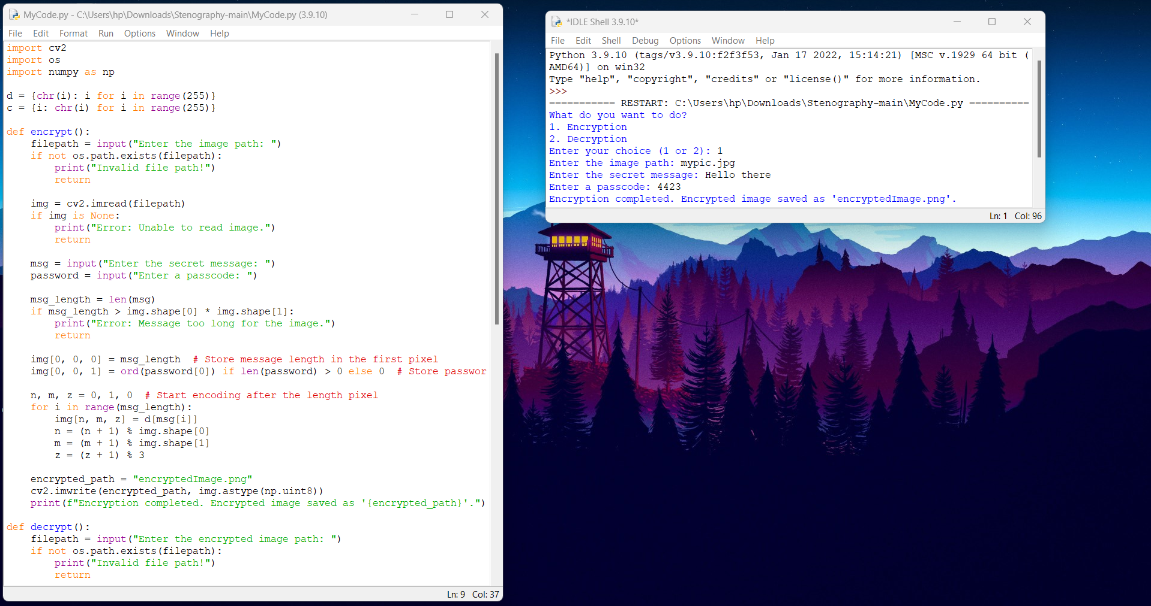
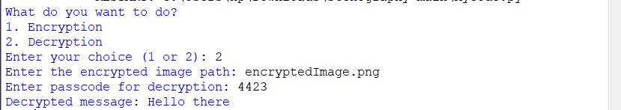
Results

Slide 8
Conclusion
This project effectively utilizes image steganography to conceal and retrieve secret messages within images securely. By subtly modifying pixel values, it ensures that the hidden data remains undetectable while preserving the original image quality. The incorporation of passcode protection adds an extra layer of security, restricting access to authorized users only. This approach offers a lightweight, efficient, and discreet solution for secure communication, with applications in cybersecurity, journalism, military intelligence, and personal privacy. Future advancements, such as AI-driven concealment and enhanced encryption, can further strengthen its security and expand its practical use cases.

Slide 9
GitHub Link
https://github.com/shrestha7953/IBM-PROJECT

Slide 10
Future scope(optional)
Advanced Encryption Integration – Combining steganography with strong encryption algorithms for enhanced security.
AI-Powered Detection Prevention – Implementing AI techniques to make hidden data even harder to detect.
Video & Audio Steganography – Expanding the technique beyond images to conceal messages in videos and audio files.
Cloud-Based Secure Messaging – Developing a cloud-based platform for seamless and encrypted steganographic communication.
Real-Time Steganographic Chat – Creating a real-time chat application where messages are hidden within shared images.

Slide 11
THANK YOU

